Slide 1


THE MEDTECH
Presented by
ASHUTOSH CHEKE(229134)
ANIKET BHUJBAL(229129)

Slide 2
Point to be Discuss through out the Presentation
Introduction
Motivation
Objective
UML Diagrams
Screenshot
Specifications
Software Requirement
Hardware Requirement
Advantages
Disadvantages
Conclusion
Future Enhancement
References

Slide 3
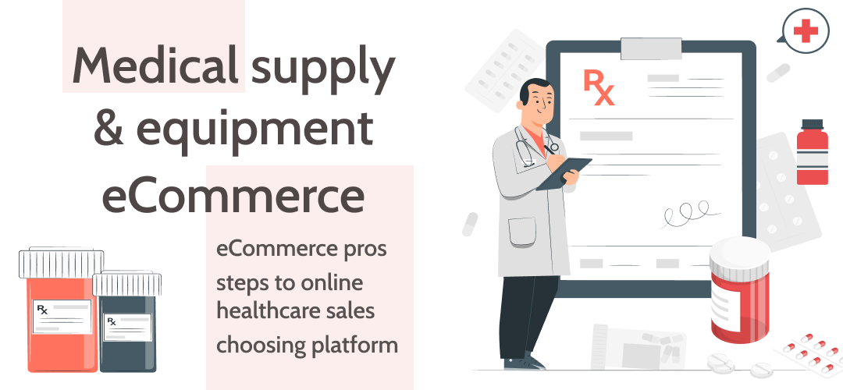
Introduction
Medical e-commerce refers to the buying and selling of medical products and services over the internet. It is a growing industry that is revolutionizing the way healthcare is delivered to customer. In this project, we aim to develop an online medical e-commerce platform that allows Customers to purchase medical products and services from the comfort of their homes.
The platform will offer a wide range of medical products and services such as prescription medications, over-the-counter medications, medical devices, and healthcare services. It will be user-friendly and easy to navigate, allowing Customers to browse, search and purchase medical products and services easily.
To ensure the quality of the products and services offered on the platform, we will partner with reputable medical suppliers and service providers. We will also implement a review system that allows Customers to rate the products and services they receive, thus ensuring that only high-quality products and services are available on the platform.
Overall, our medical e-commerce platform will provide Customers with a convenient and secure way to purchase medical products and services. It will also help healthcare providers to expand their reach and offer their services to a wider audience.

Slide 4

Improved accessibility: An ecommerce medical site can provide better access to medical supplies, equipment, and other products for people who live in remote areas or have limited mobility. This can help improve their quality of life by providing them with essential medical products that they may not be able to get otherwise.
Convenience: An ecommerce medical site can offer the convenience of shopping for medical supplies and equipment from the comfort of one's own home. This can save time and effort that would otherwise be spent visiting physical stores or medical supply shops.
Lower costs: An ecommerce medical site can offer competitive prices on medical supplies and equipment due to lower overhead costs. This can benefit both customers and healthcare providers who need to purchase medical supplies in bulk.

Slide 5
Objective
Providing a user-friendly interface that allows customers to easily search, browse, and purchase medical products online.
Offering a wide range of high-quality medical supplies and equipment, including hard-to-find items and specialty products.
Ensuring that all products sold on the ecommerce site are safe, reliable, and meet the necessary quality standards.
Ensuring that all transactions are secure, including implementing secure payment processing systems and protecting customer data.
Providing timely and reliable shipping and delivery services to ensure that customers receive their products in a timely manner.
Offering competitive pricing on medical products, as well as providing discounts and promotions to incentivize repeat business.

Slide 6
Unified Modelling language (UML Diagram)

Slide 7
Admin
Manage Users and Full Application
Manage Buyers
Admin
Manage Vendors
Login and Logout from System
Check Product details
Update My Profile
Change Account Password
Check Product reviews

Slide 8
Vendor
Create Product Details
Update Product Details
Vendor
Delete Product Details
Login and Logout from System
Change Account Password
Make Payment
Add To Cart
View Product Details
search Product

Slide 9
User
Login and Logout from System
Update My Profile
User
Change Account Password
search Product
Make Payment
View Product Details
Add To Cart

Slide 10
Entity Relationship Diagram

Slide 11
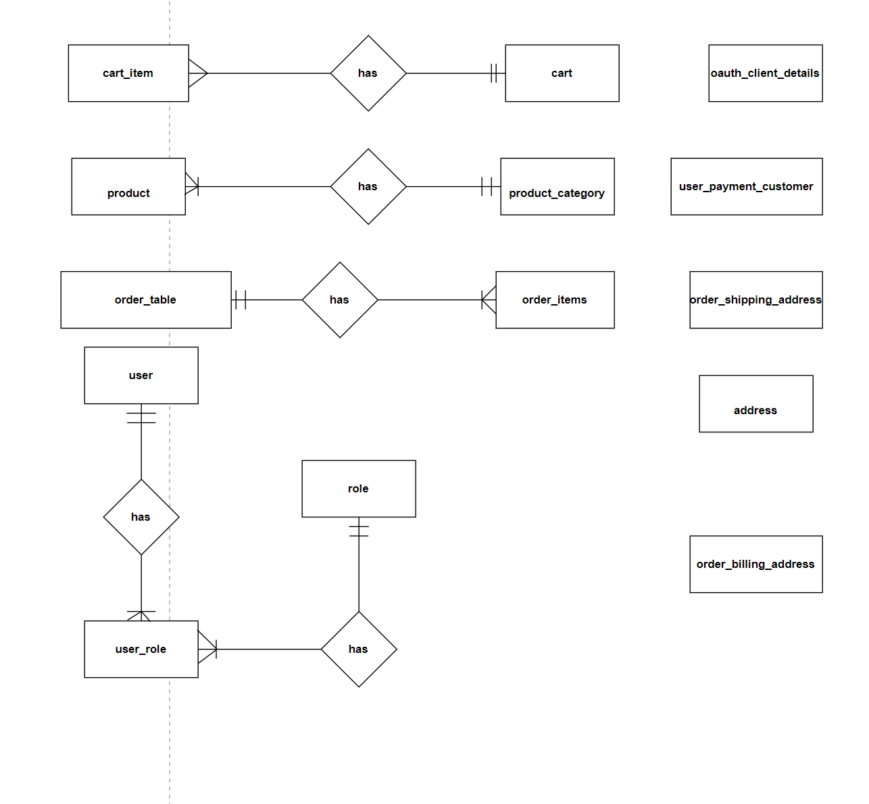

Slide 12
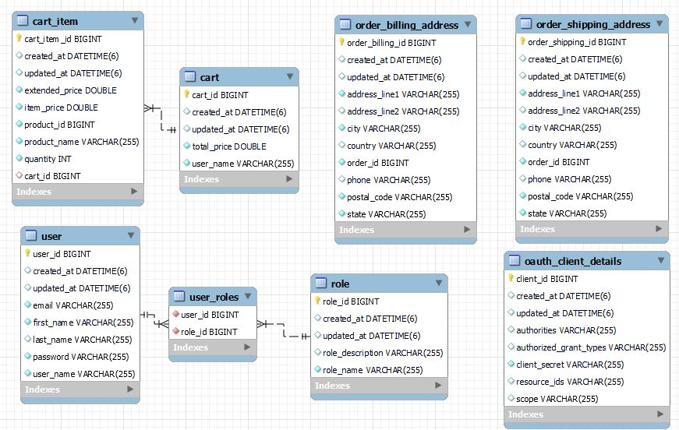

Slide 13
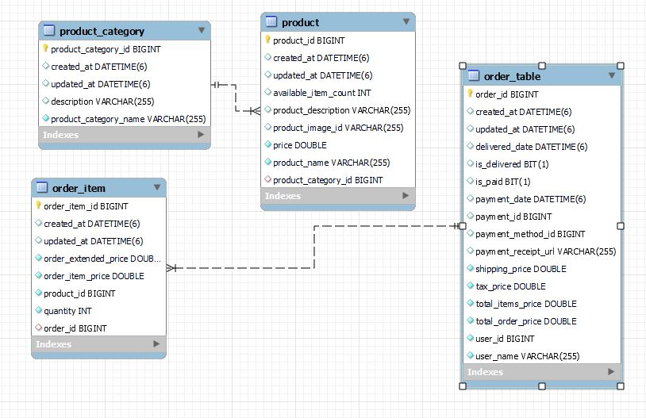

Slide 14
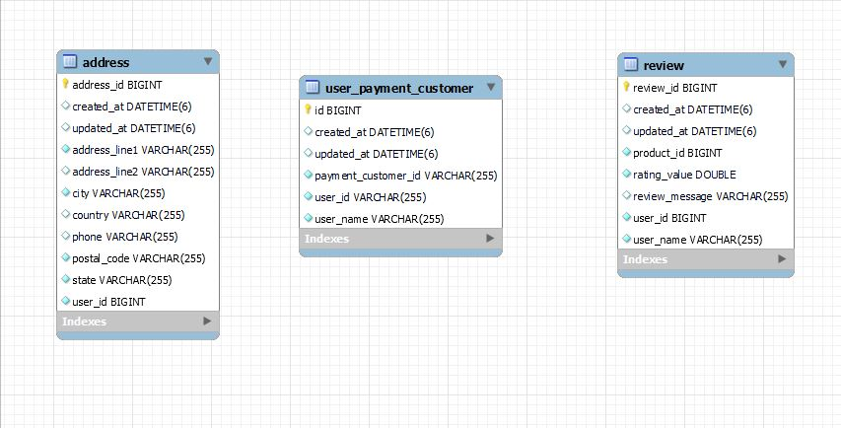

Slide 15
Activity Diagrams

Slide 16
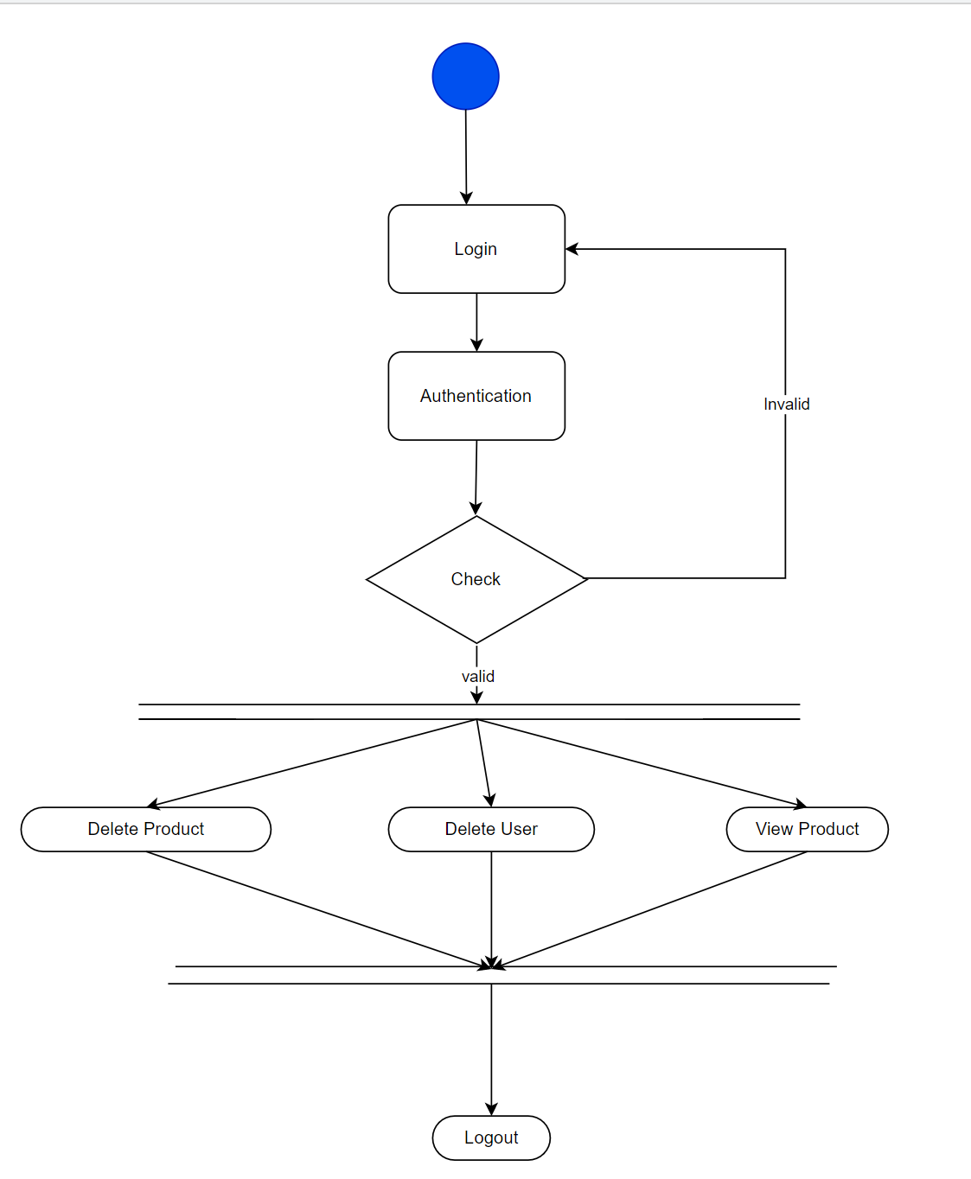
Activity Diagram of Admin

Slide 17
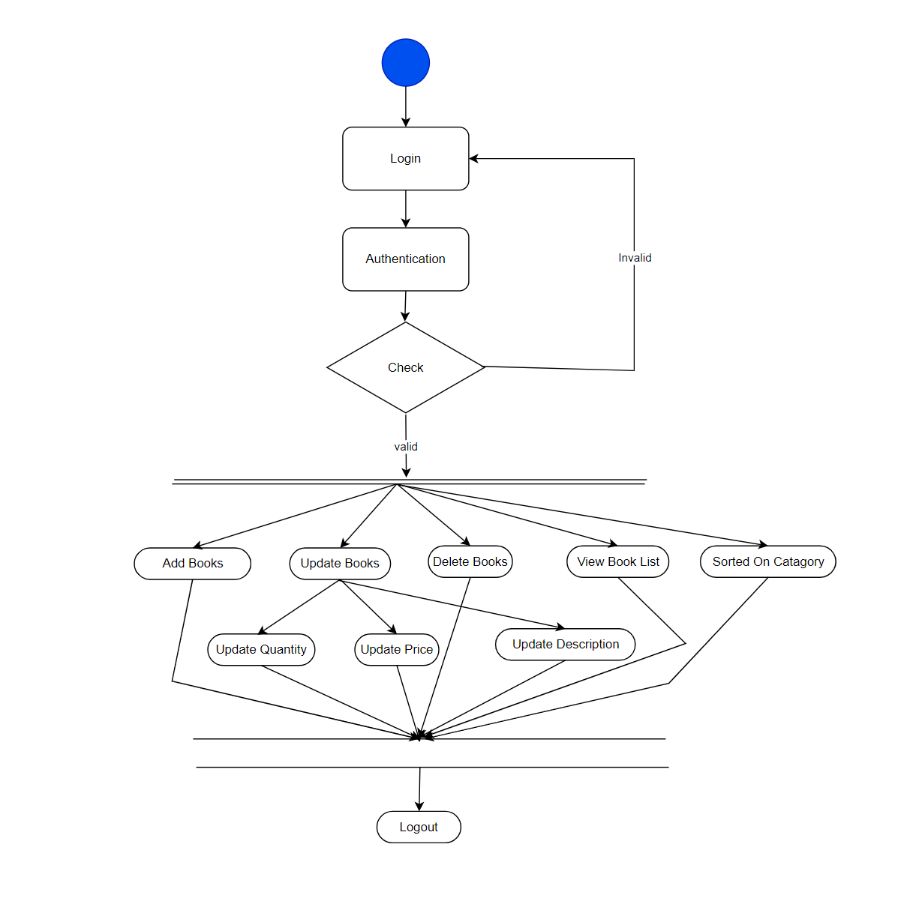
Activity Diagram of Vendor

Slide 18
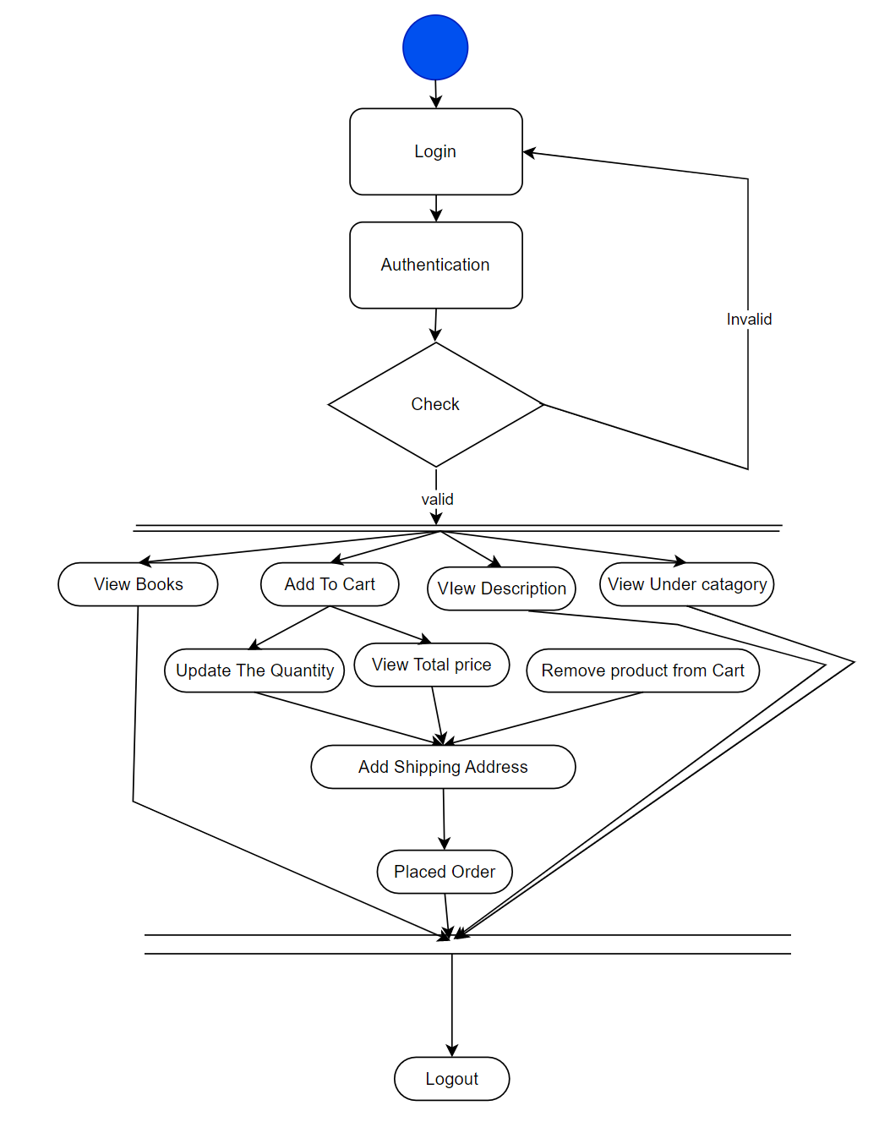
Activity Diagram Of User

Slide 19
Sequence Diagram

Slide 20
Login Page
Forgot Password
Verification
Database
Authenticate Page
Admin
Fogot Password
login to page
Check Authenticity for access
Check Login Details
Valid Lodin Details
Provide Authorization for access
Check Security Question and Answer
Create session
in and store
in Database
Allow user to
Access the internal Page
on base of User
and session
Send email to user to reset Password
Invalid login Details
Allow User to Access the pages
Logout from application
Destroy Session and tokes from database
Login Successfully

Slide 21
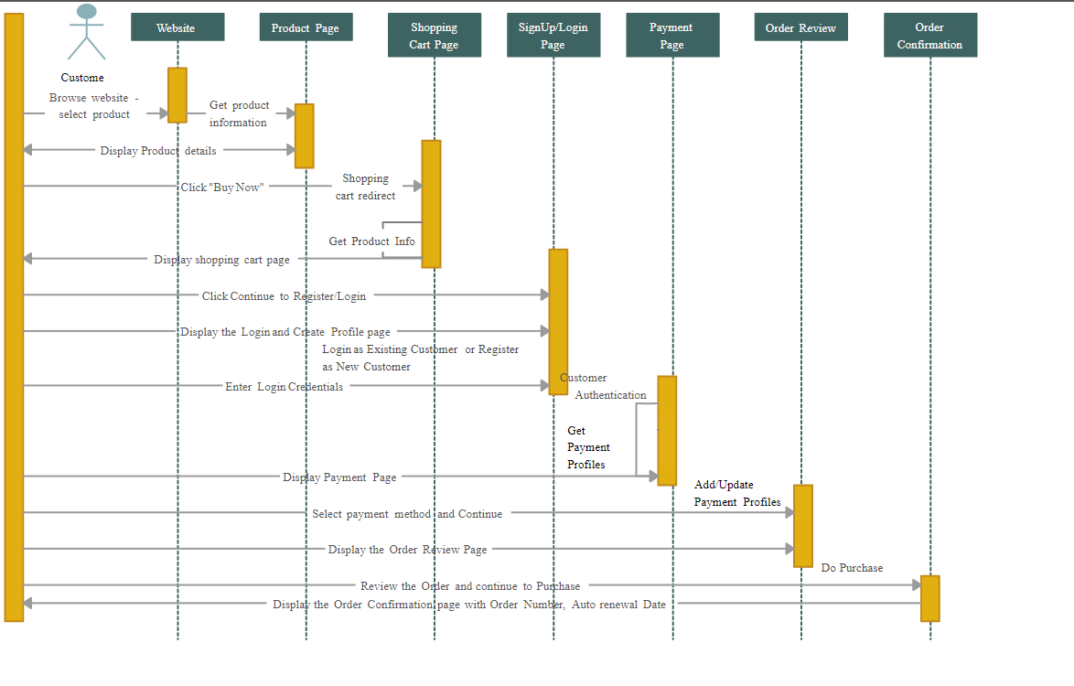
Screenshots

Slide 22
Screenshots

Slide 23
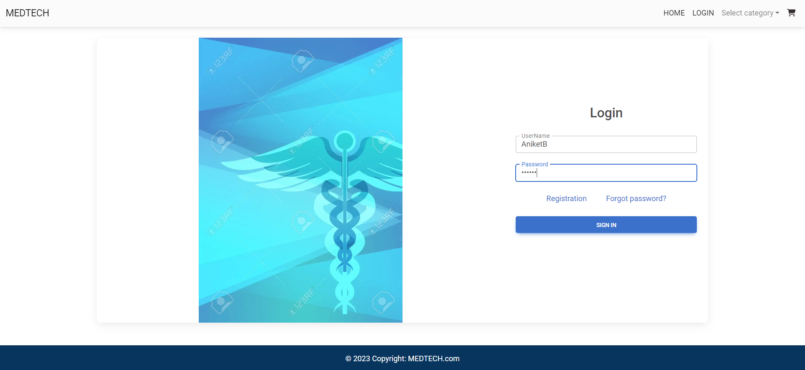
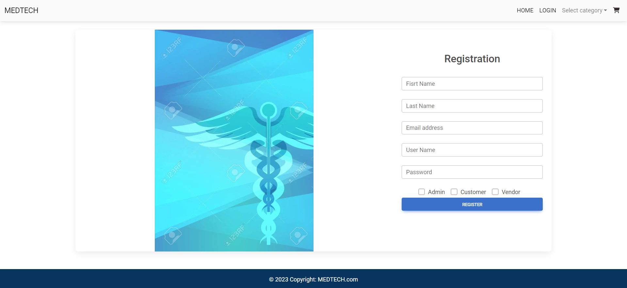
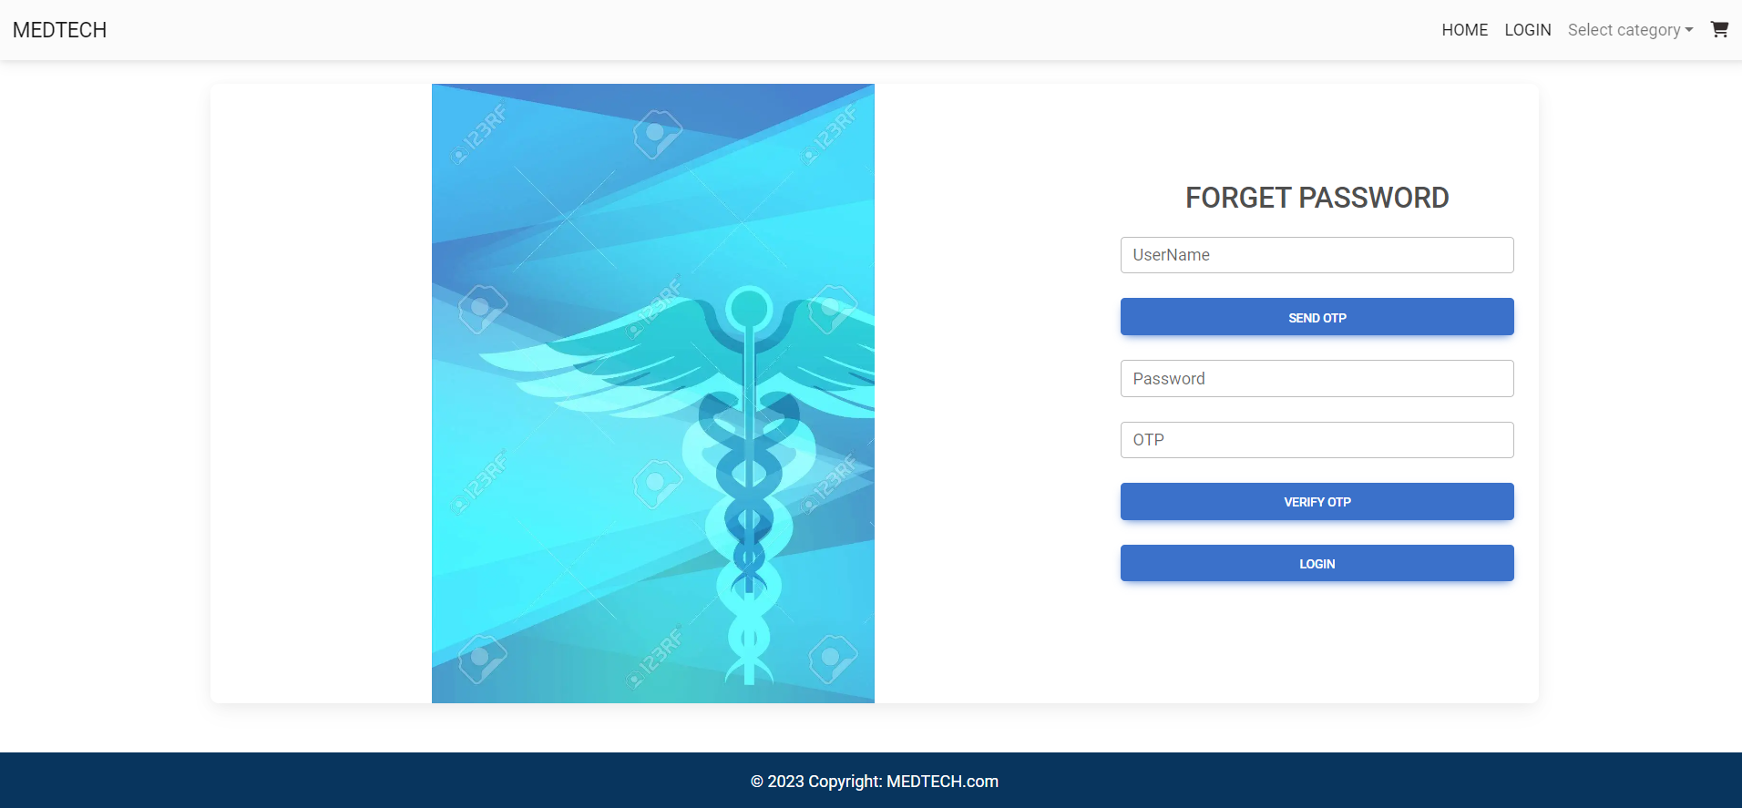

Slide 24
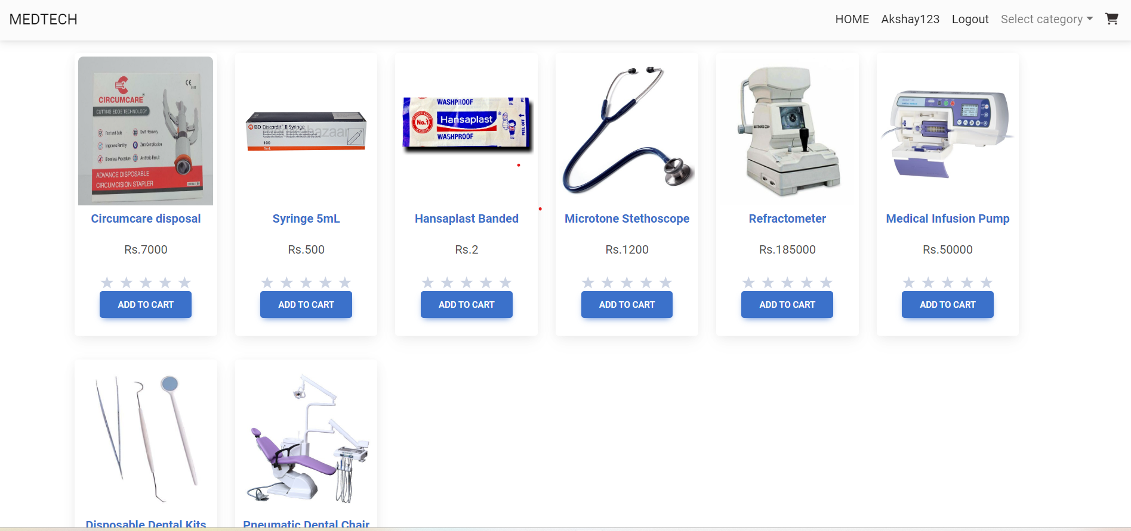
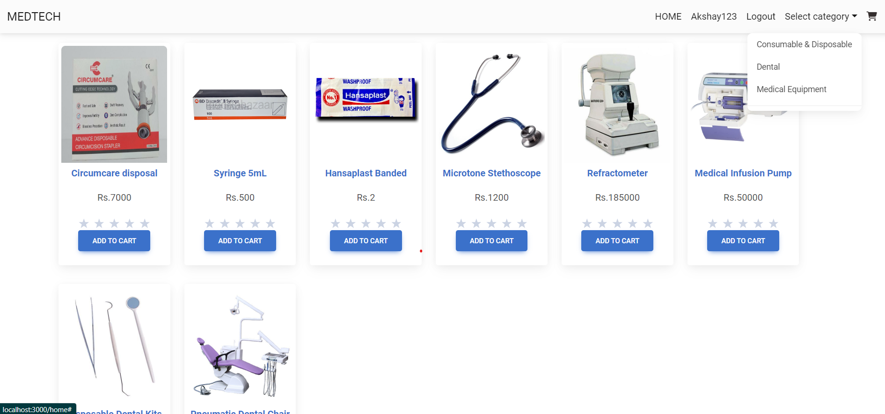
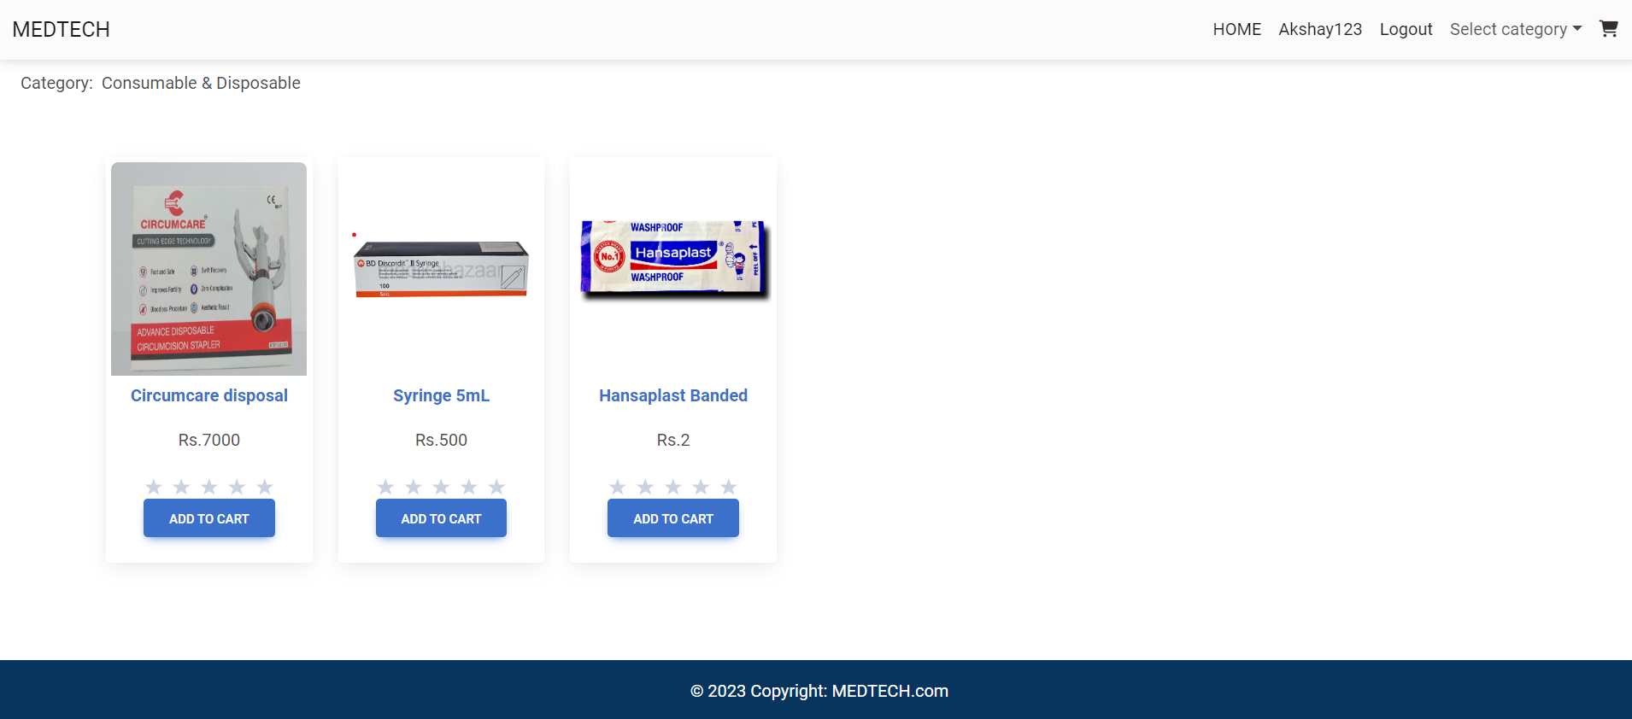
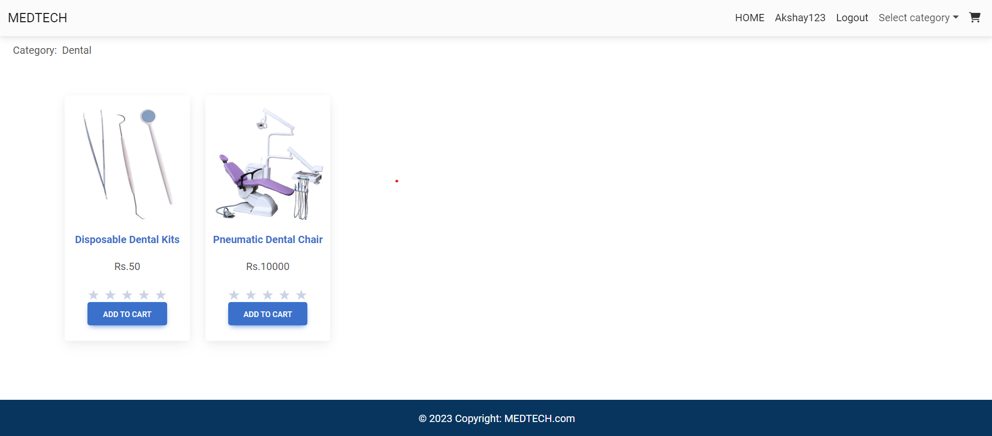

Slide 25
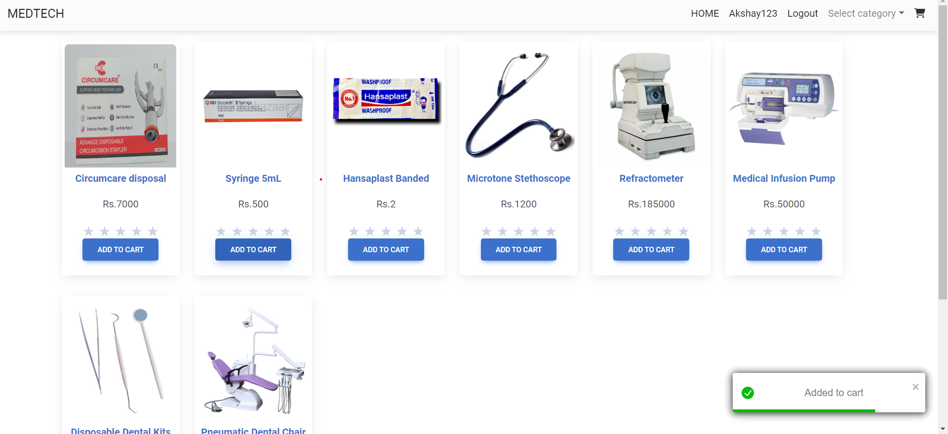
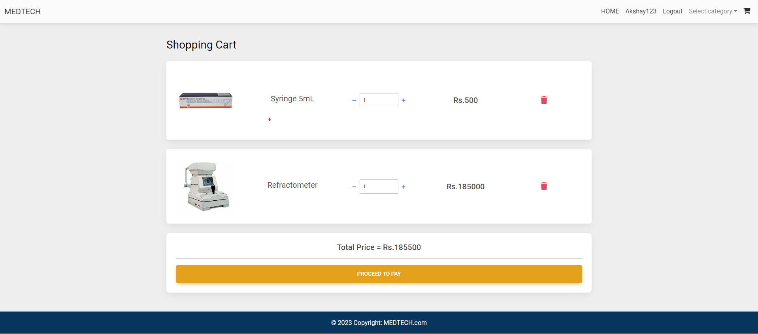
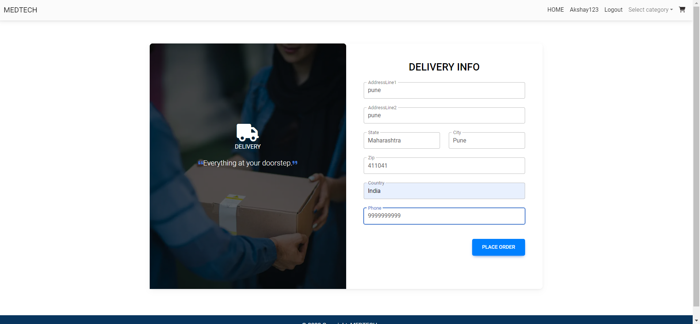
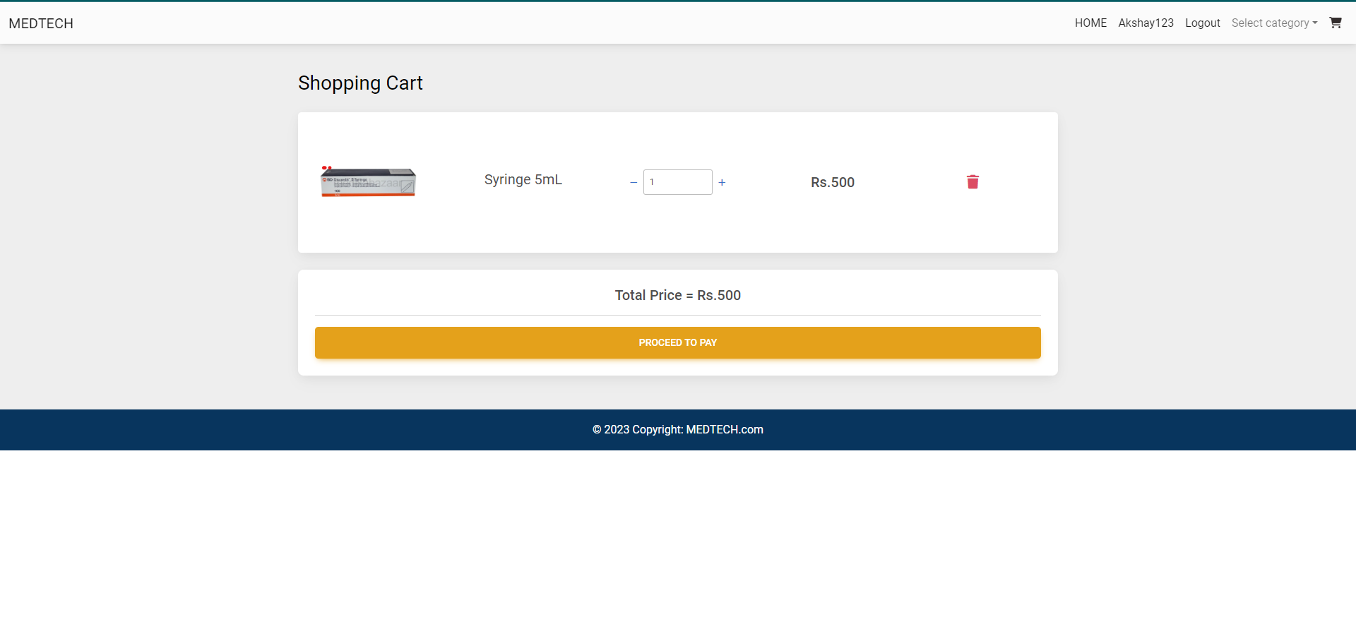

Slide 26
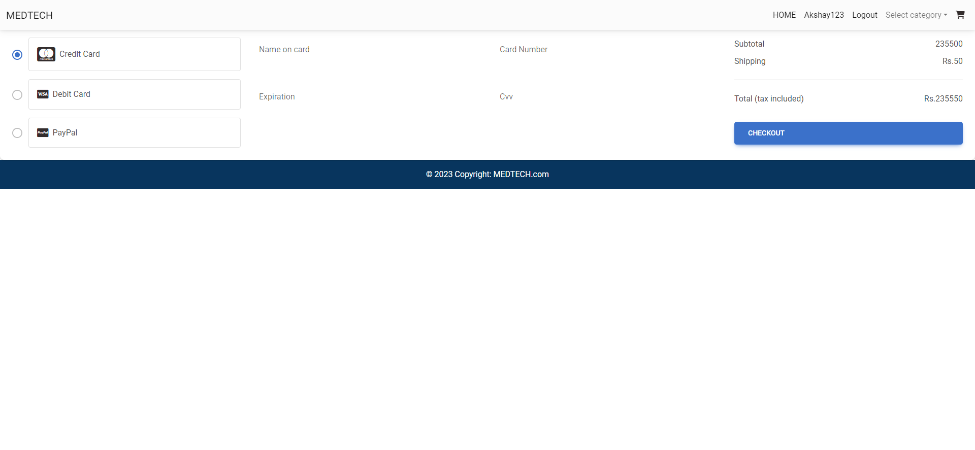
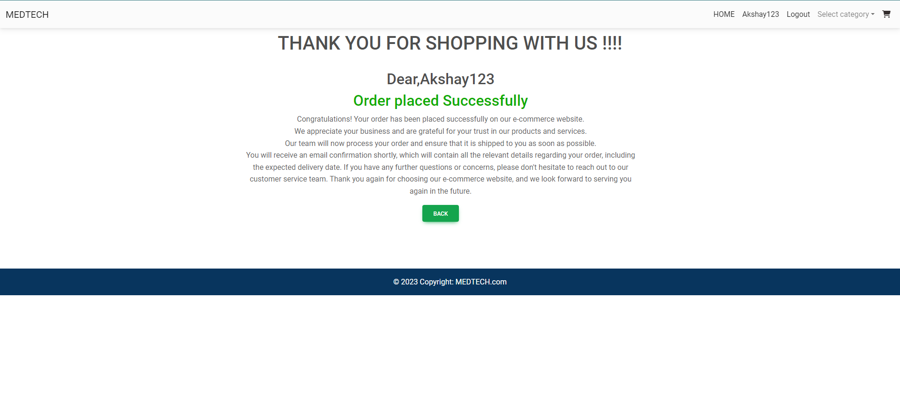
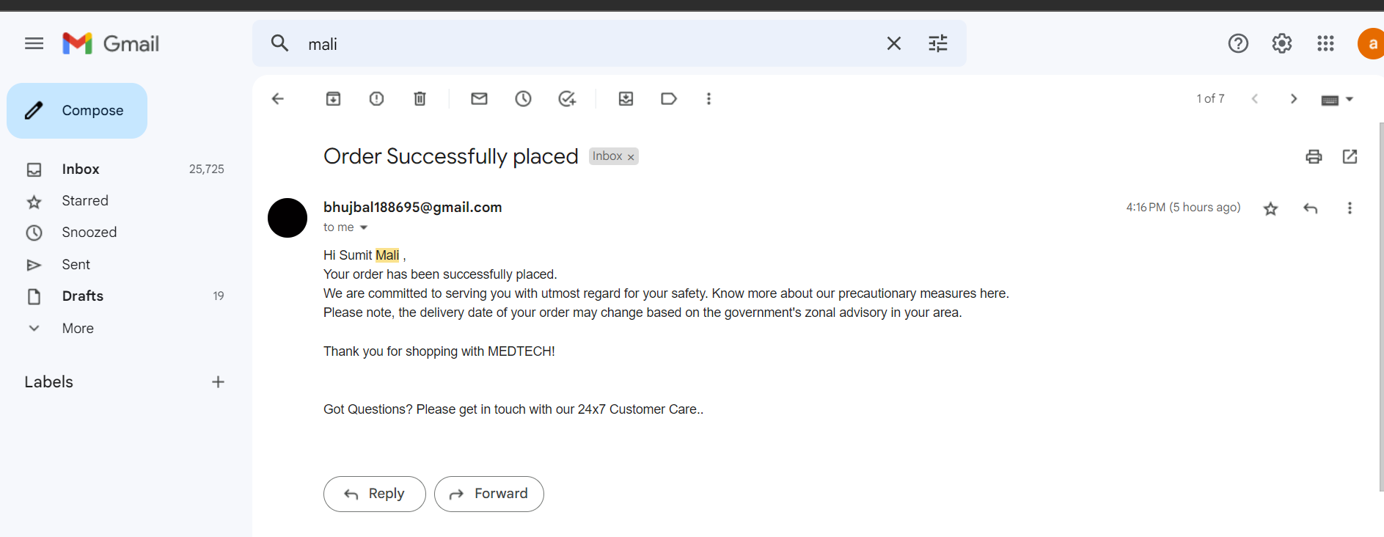

Slide 27
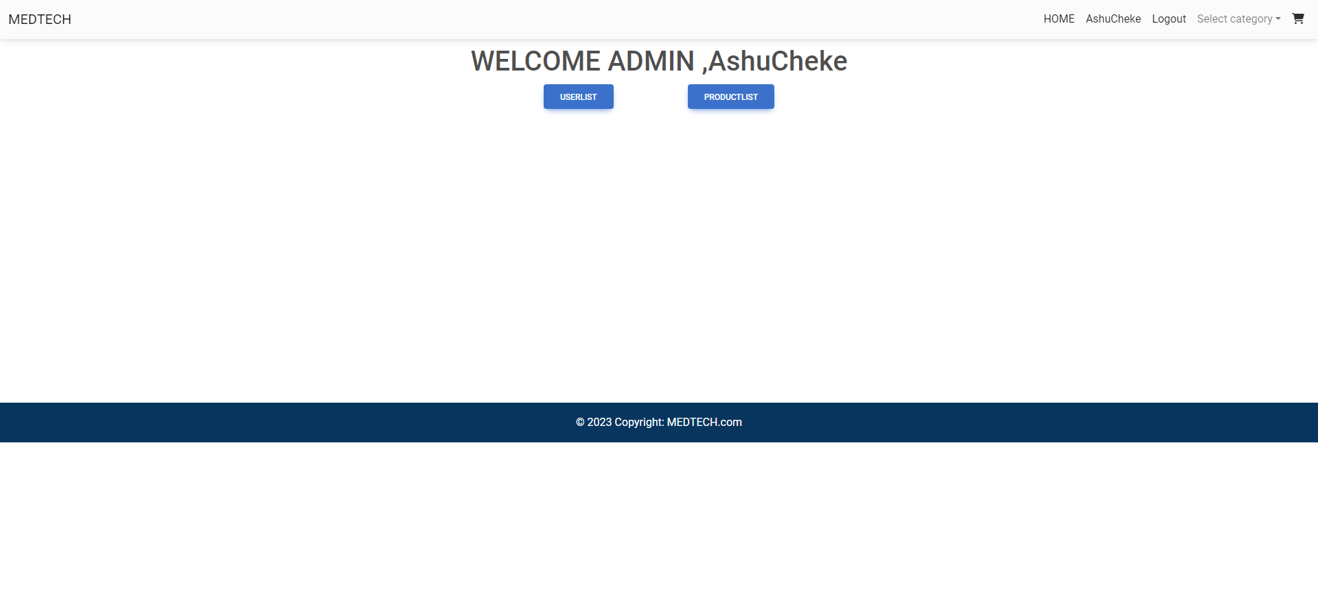
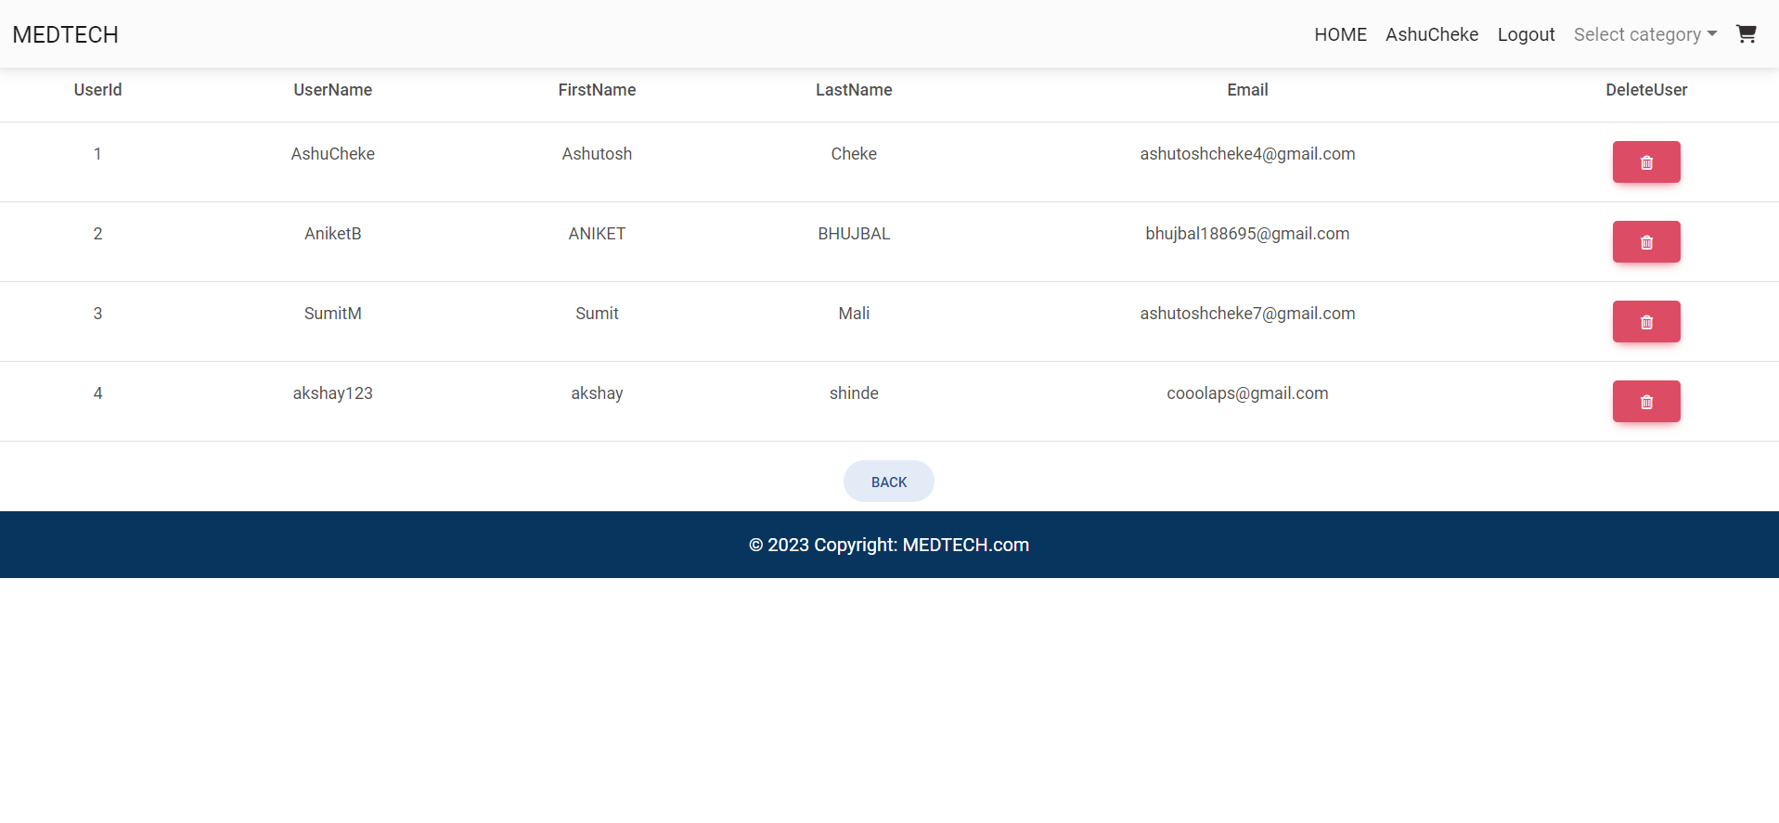
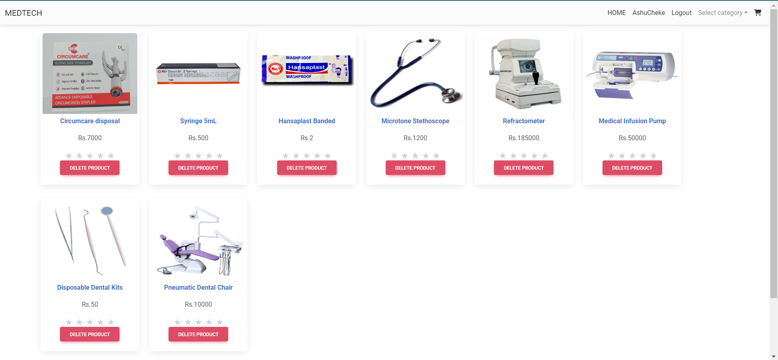
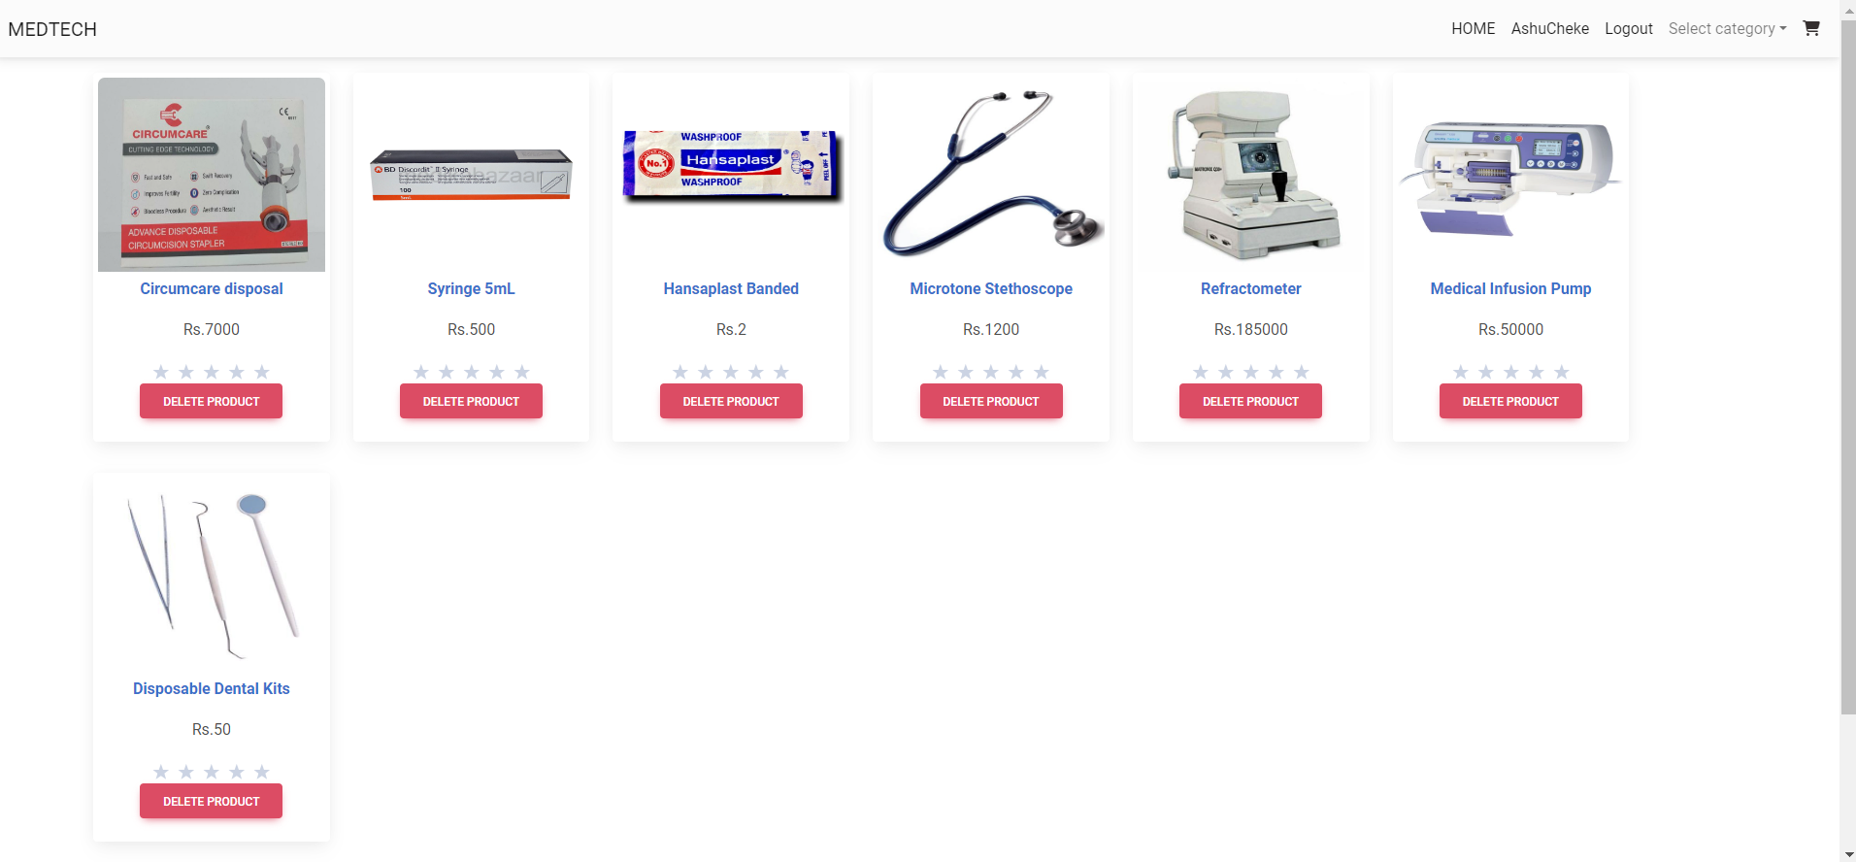

Slide 28
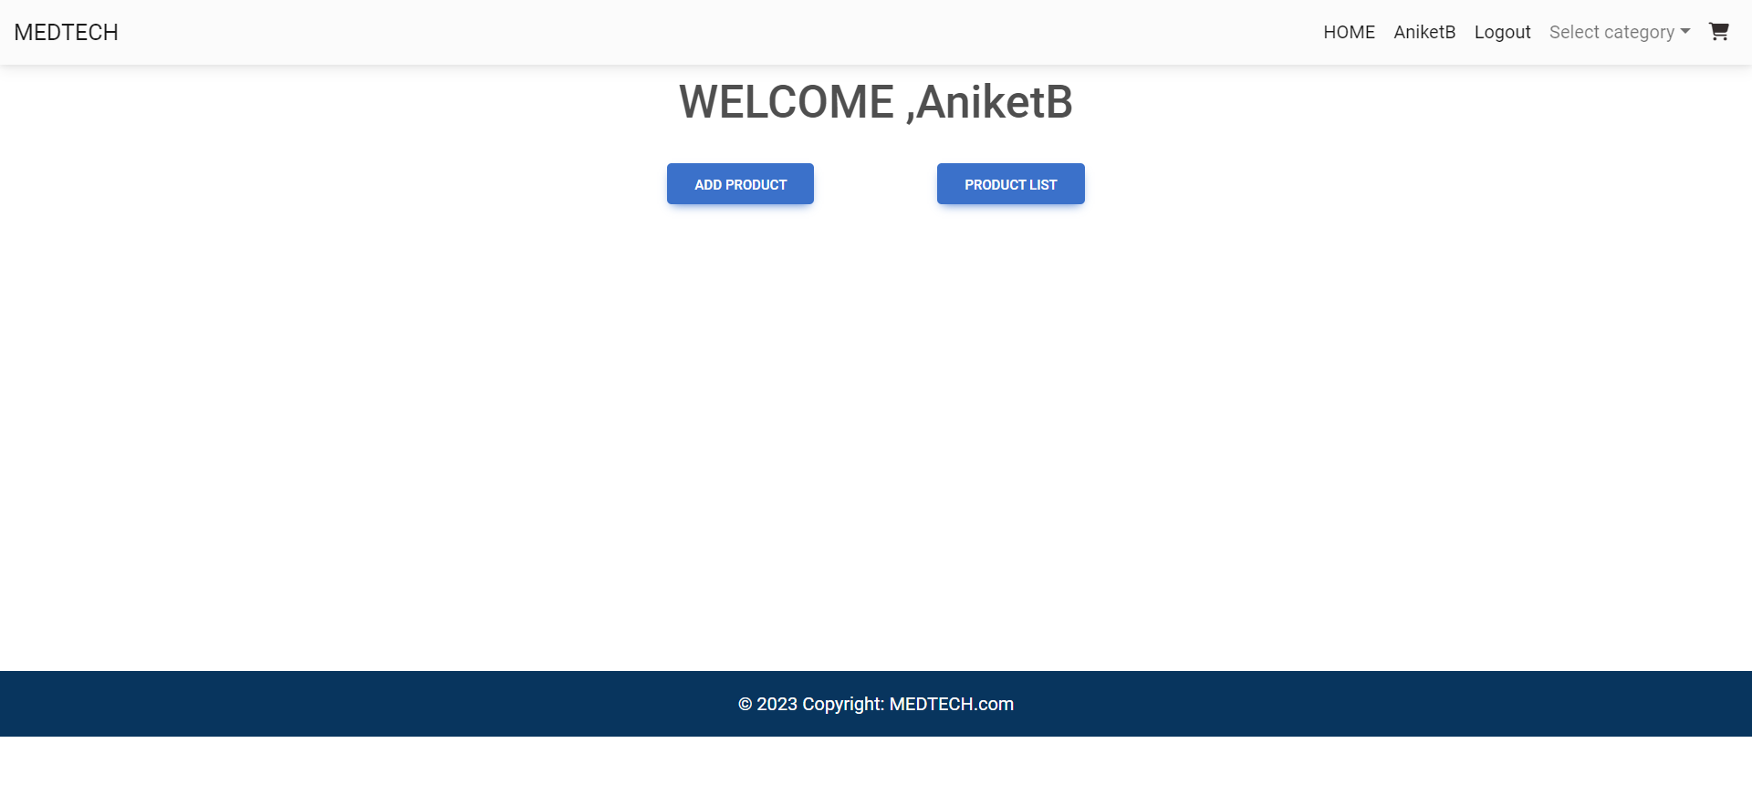
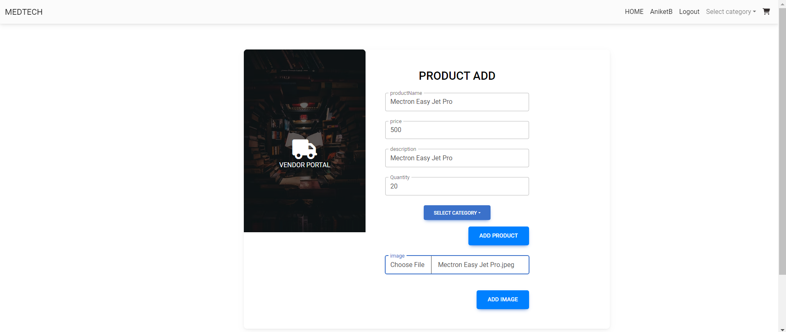
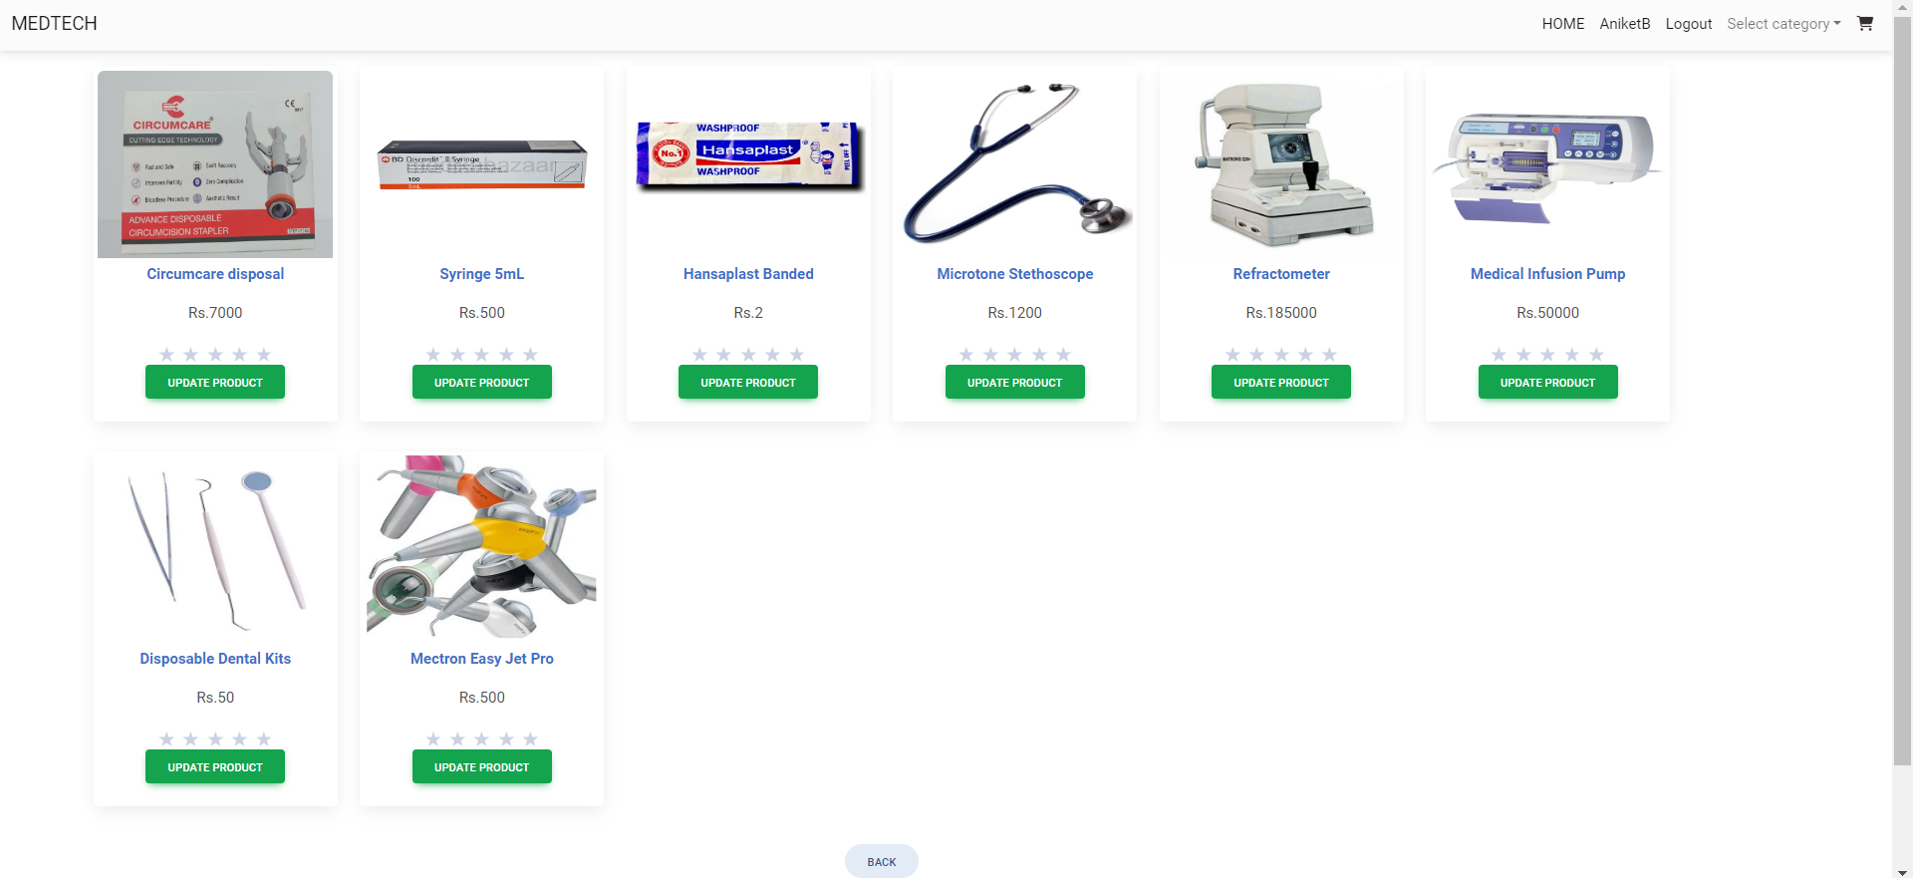
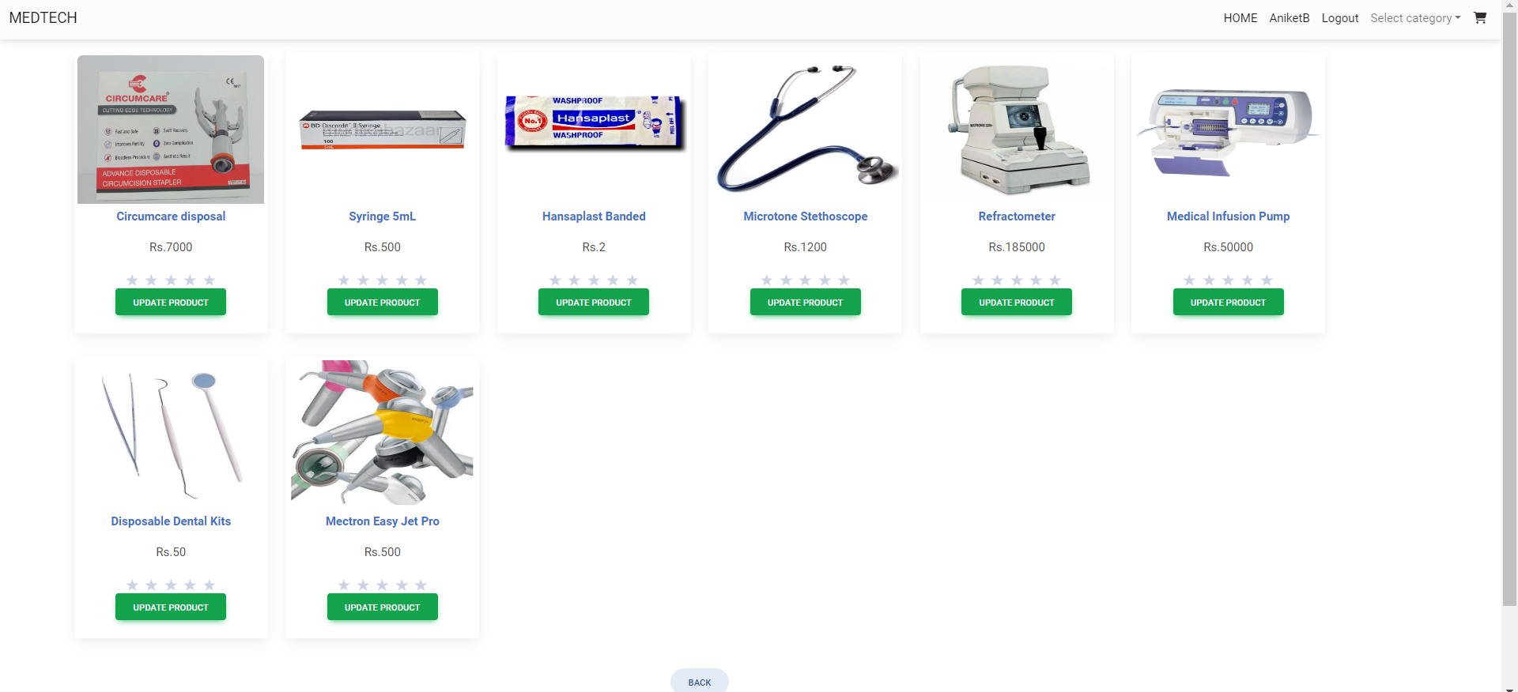

Slide 29
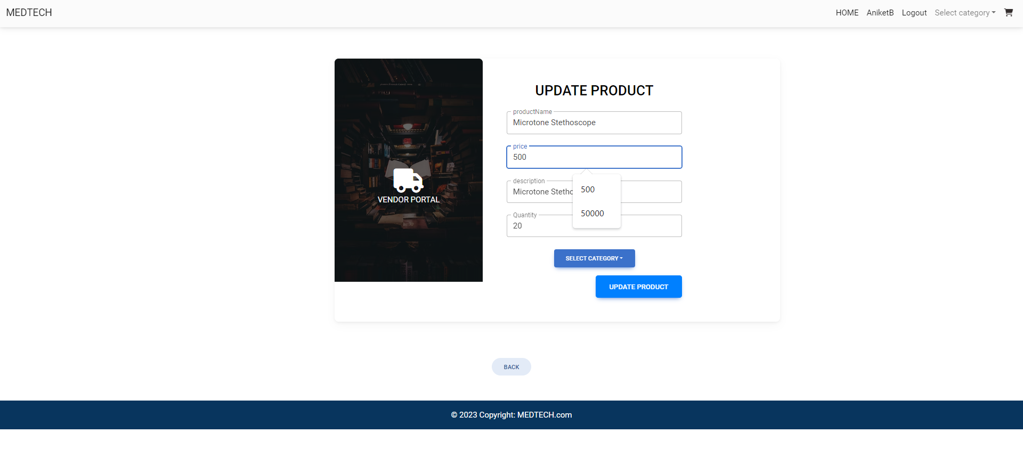
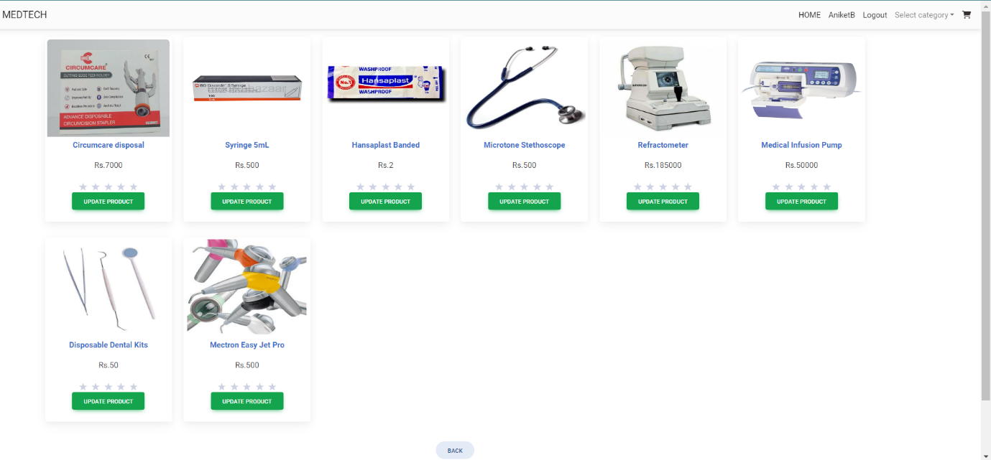
Screenshots

Slide 30
Screenshots

Slide 31
Specifications
The application will use JavaScript, jQuery and CSS as main web technologies.
HTTP and FTP protocols are used as communication protocols. FTP is used to upload the web application in live domain and the client can access it via HTTP protocol.
SMTP protocol is used for Email communication.
Several types of validations make this web application a secured one and SQL Injections can also be prevented.
Since Student’s Online Portal is a web-based application, internet connection must be established.
The Student’s Online Portal will be used on PCs and will function via internet or intranet in any web browser

Slide 32
Software And HardwareRequirement
Server Side:
Processor: Intel® Xeon® processor 3500 series
HDD: Minimum 500GB Disk Space
RAM: Minimum 4GB
OS: Windows 10, Linux 6
Database: MySQL
Client Side (minimum requirement):
Processor: Intel Dual Core
HDD: Minimum 80GB Disk Space
RAM: Minimum 2GB
OS: Windows 7, Linux

Slide 33
Advantages
Vendor and Customer can access the website from anywhere
Even the Publication House can list their product on the websites
Adding new Product to the web-site is very easy
Get the Medical Product at your doorsteps
User Interface is user-friendly
Price of the product is justified

Slide 34
Disadvantages
Sometime the site get crash so that time no one can access that site .
Customer cannot try the product before they buy.
Sometime the in the delivery the product get damage .
E-commerce is highly competitive.
Shipping time can be lengthy

Slide 35
Conclusion
In the competitive world if you want to grow rapidly you must use the web application to grow the business.
User-friendly interface : The online store should have an easy-to-use and intuitive interface that allows customers to quickly and easily find the books they are looking for.
Customer can order the book from any part of the country at their door steps
Vendor don’t have limited customer because of the website he/she can sell the book all over the country

Slide 36
Future Enhancement
We will handle complete delivery system
We will handle complete payment system
Review generation for product as per the category
Admin will get the notification as per update

Slide 37
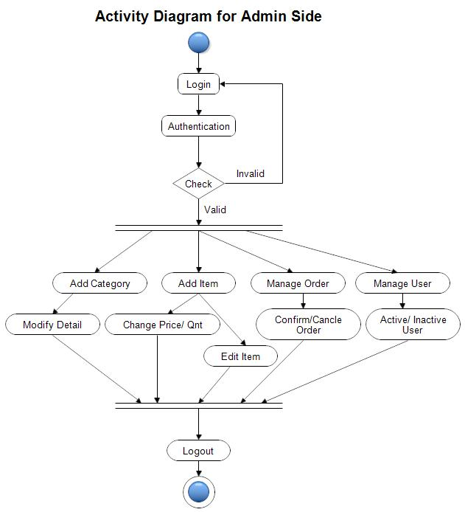

Slide 38
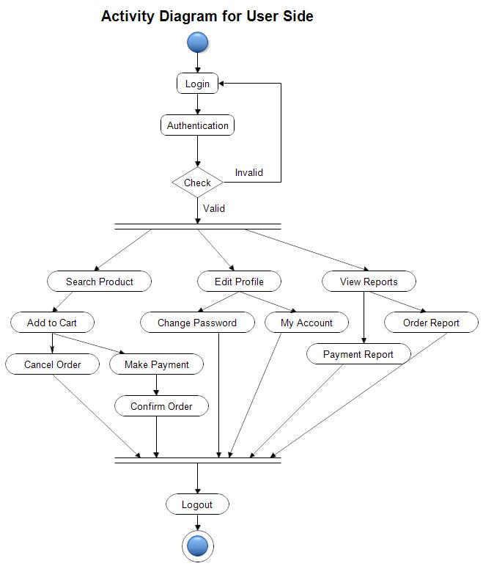

Slide 39
References
https://bootstrapmade.com/mentor-free-education-bootstrap-theme/
https://www.javatpoint.com/java-mail-api-tutorial
https://www.w3schools.com/
https://reactjs.org/docs/getting-started.html
https://javaee.github.io/javaee-spec/javadocs/

Slide 40
Thank you

